Slide 1
Welcome Back
Mrs. Well's Grade 1
Burton Elementary School

Slide 2
Schedule
7:40 Bus arrival
7:45-7:55 Student drop off
10:05 Morning Recess
11:35 Lunch
11:55 Lunch Recess
1:45 Dismissal
Friday - 11:50 Dismissal
Physical Education will be on Mondays, Tuesdays, Wednesdays.
Library will be on Friday's with Barb Podonivitch

Slide 3
Supplies
Change of clothes (pants, shirt, underwear, sock-all labeled with name and stored in a plastic bag labeled with name)
Indoor sneakers (preferably Velcro)
Book bag and lunch box
Water bottle
1 large and 1 small box of Ziploc Bags
1 box of tissues
2 community masks
$ 25 for remaining school supplies and a $10 Agenda fee (please pay both fees via School Cash Online. - This can be found on school website)

Slide 4
Homework
Homework will be sent home on Monday for the week and expected back on Friday.
Homework usually consist of nightly reading and sight word practice.
Homework notices/reminders will be glued into agendas at the beginning of each week.
The Jolly Phonics program will continue to be sent home for the first few weeks of school.
Agendas will travel back and forth to school each day. Please check agenda daily for notices.
When sending notes to school please place in the plastic sleeve inside your child's agenda.

Slide 5
Websites
Your child will have their own Raz kids account for online reading. They will be using this at school and are encouraged to use it at home . Login instructions will be sent home when available.
Please check our school website frequently to stay up to date on all school-related activates. https://secure1.nbed.nb.ca/sites/ASD-W/burton/Pages/default.aspx

Slide 6
Contact Info
School Phone: 357-4074
Email: wendy.wells@nbed.nb.ca
If your matter is time sensitive, (i.e. your child is getting picked up after school instead of taking the bus), Please phone the school and Mrs. Morabito will give me the message immediately as I don't always get a chance to check my email during instructional hours.
If any of your personal information changes, please contact the school as soon as possible.

Slide 7
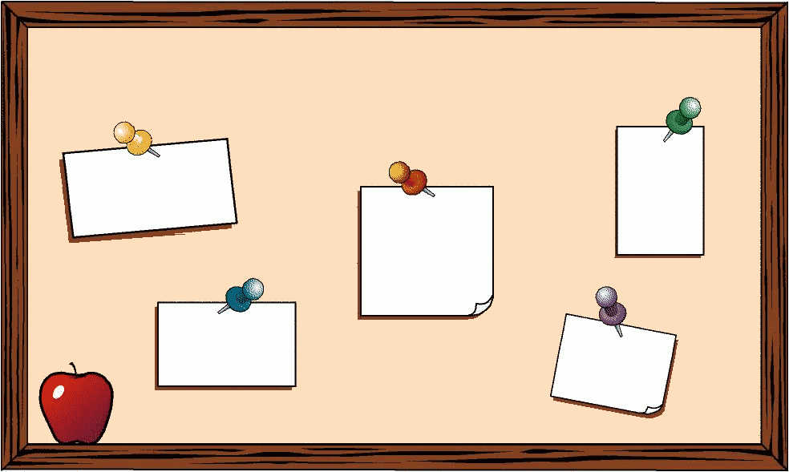
General Info
Toys will not be allowed at school. If transporting items to daycare, items will be expected to stay in the bookbag.
Birthday invitations are fine to send to school. However, students will not be passing them out. The teacher will place them in agendas.
There will be a hot lunch program this year—more details to follow.

